Slide 1
Journey ppt week 3

Slide 2
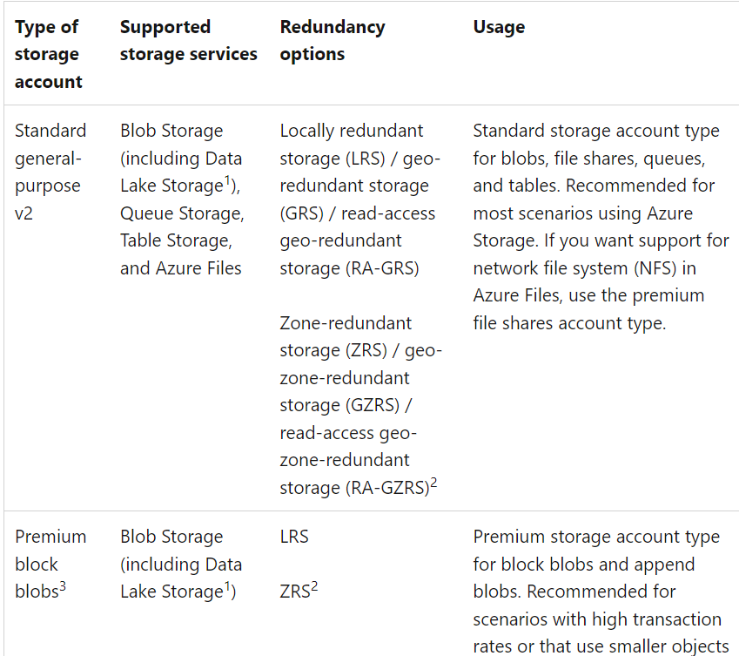
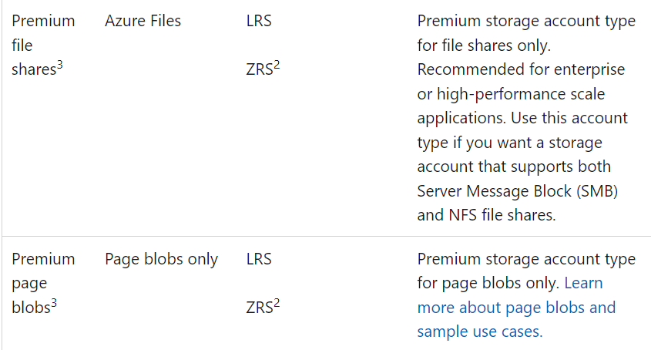
Azure storage account
An Azure storage account contains all of your Azure Storage data objects: blobs, files, queues, and tables.
Types of storage accounts
Azure Storage offers several types of storage accounts. Each type supports different features and has its own pricing model.

Slide 3
Benefits of Azure Storage
Durable and highly available
Secure.
Scalable.
Managed.
Accessible.
Azure Storage data services
Azure Blobs: A massively scalable object store for text and binary data. Also includes support for big data analytics through Data Lake Storage Gen2.
Azure Files: Managed file shares for cloud or on-premises deployments.
Azure Queues: A messaging store for reliable messaging between application components.
Azure Tables: A NoSQL store for schema less storage of structured data.

Slide 4
What is Azure Blob storage?
Azure Blob Storage is Microsoft's object storage solution for the cloud. Blob Storage is optimized for storing massive amounts of unstructured data. Unstructured data is data that doesn't adhere to a particular data model or definition, such as text or binary data.
About Blob Storage
Blob Storage is designed for:
Serving images or documents directly to a browser.
Storing files for distributed access.
Streaming video and audio.
Writing to log files.

Slide 5
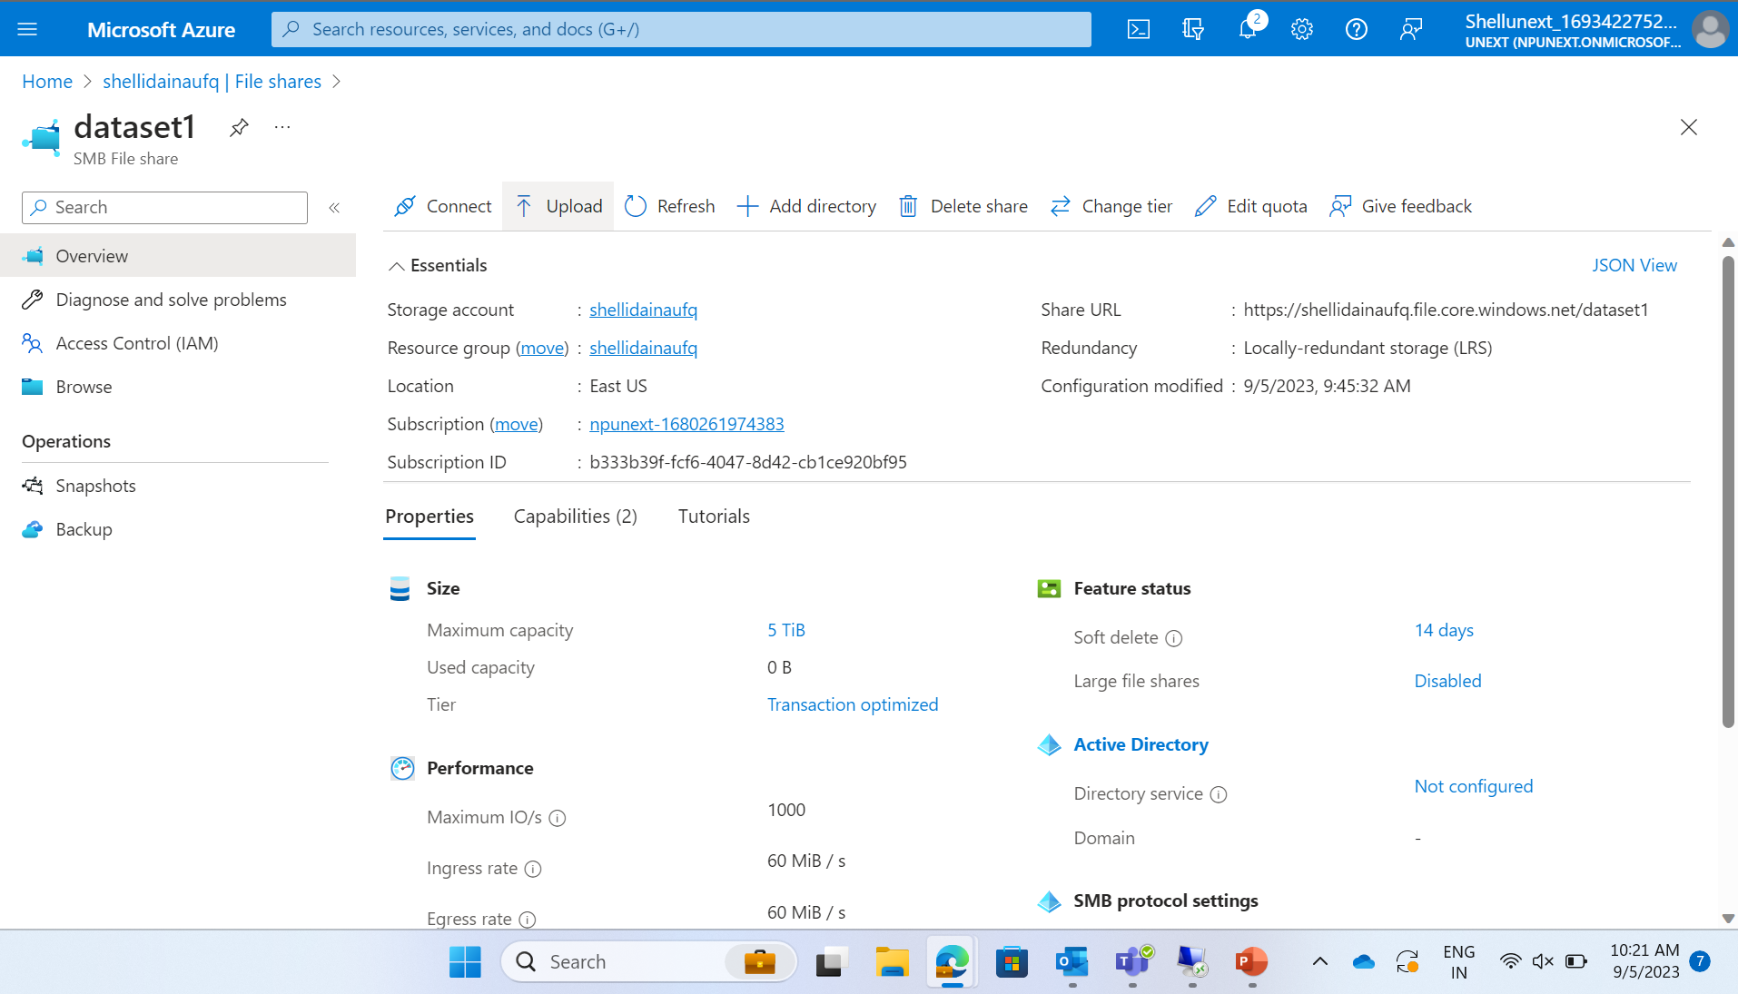
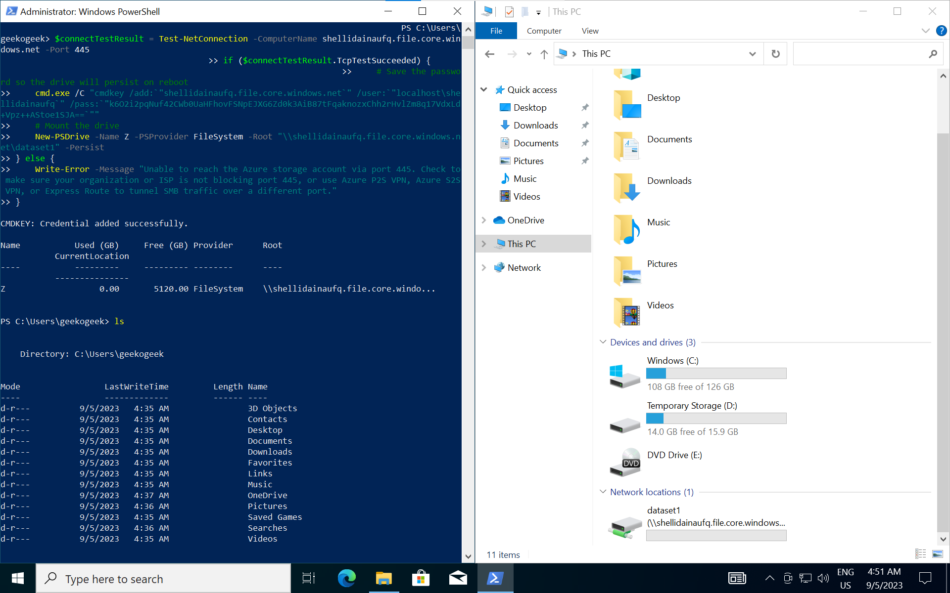

Creating a file sharing storage account and connecting it via a VM

Slide 6
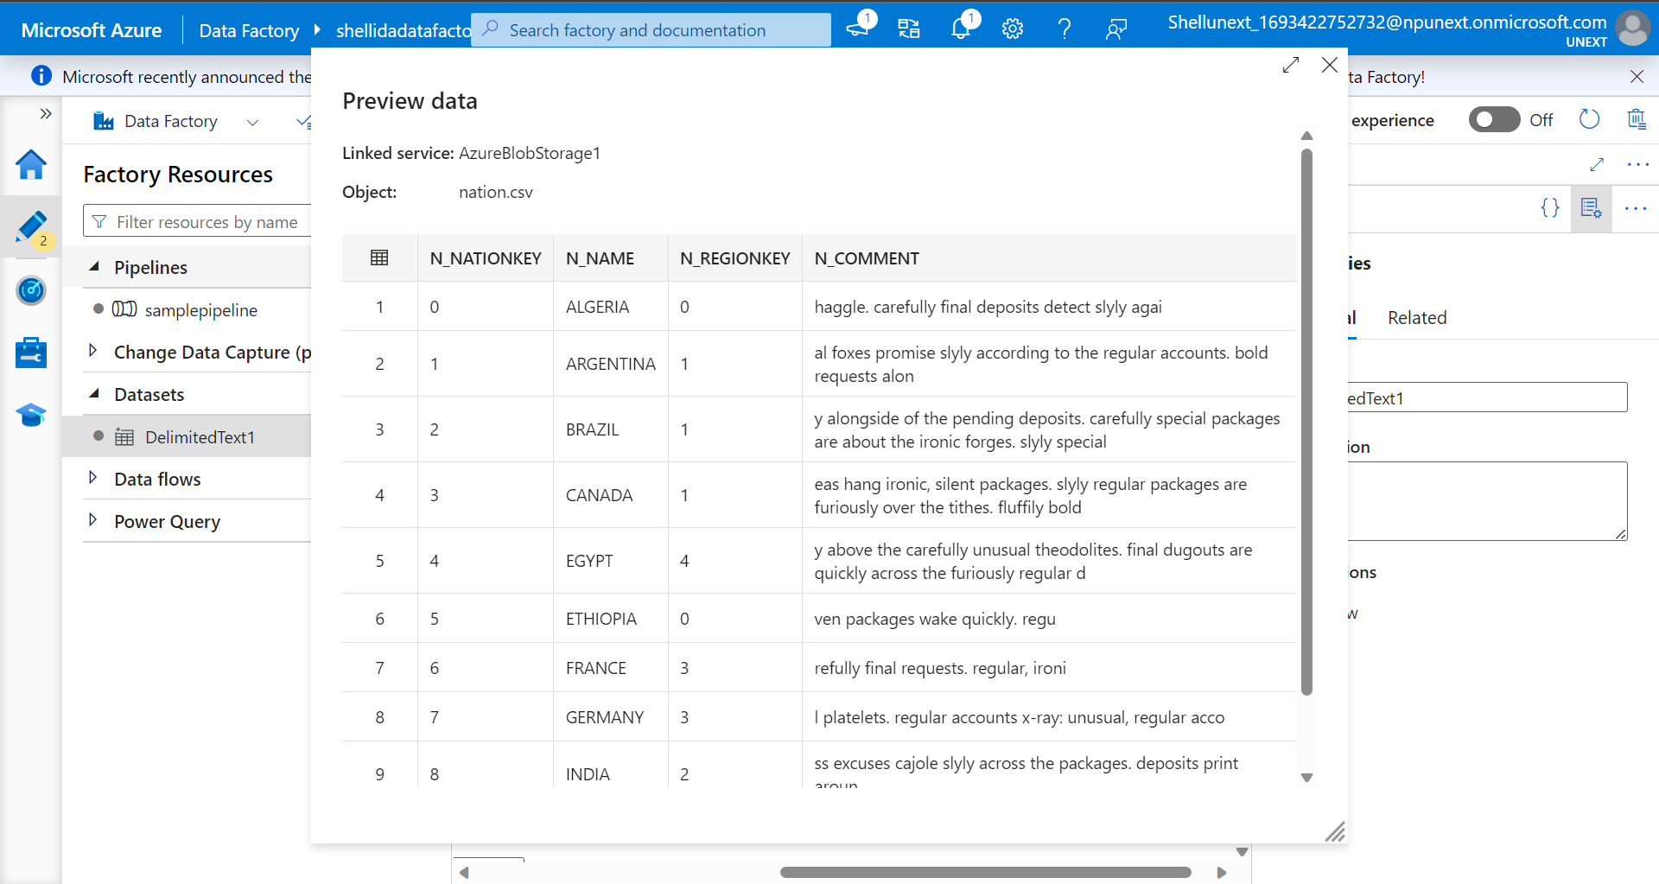
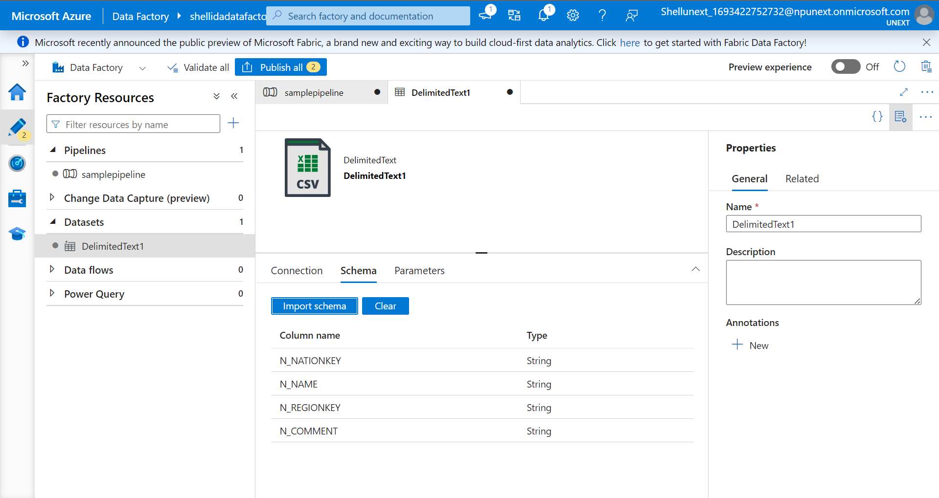
Creating a pipeline in azure data factory

Slide 7
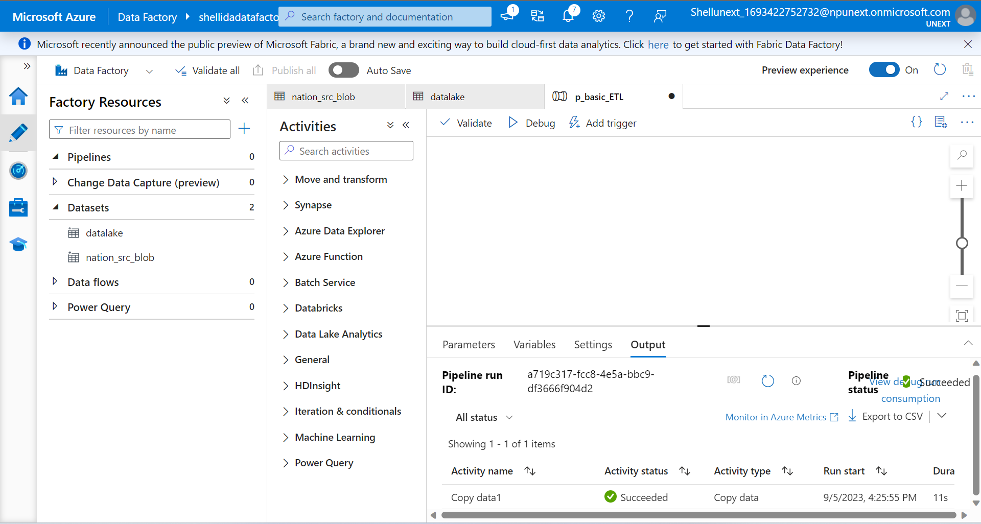
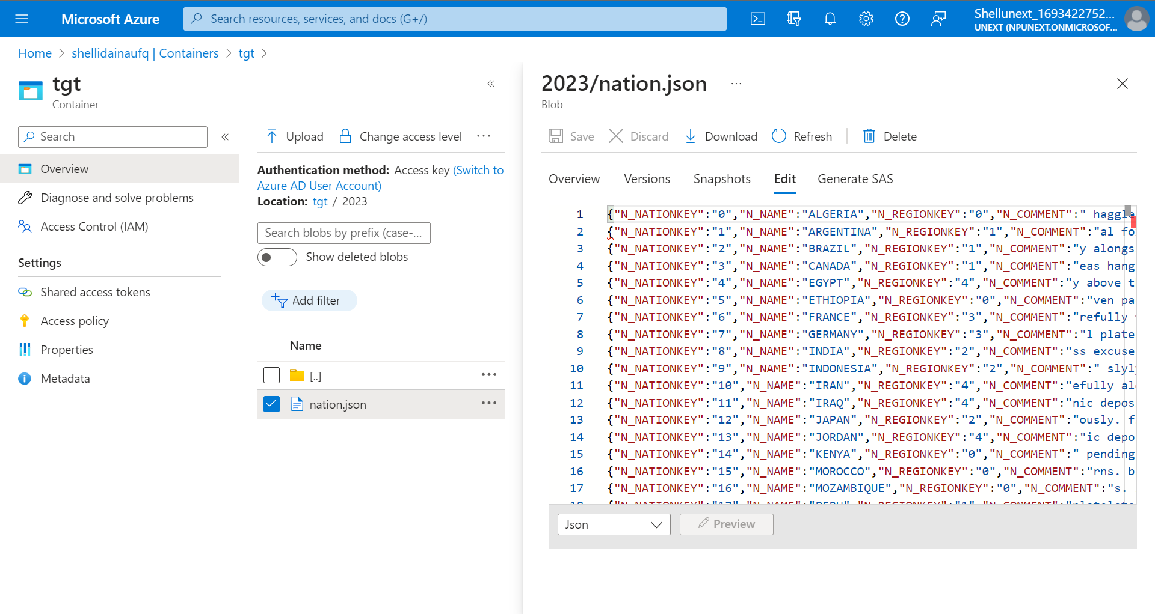
Creating a pipeline

Slide 8
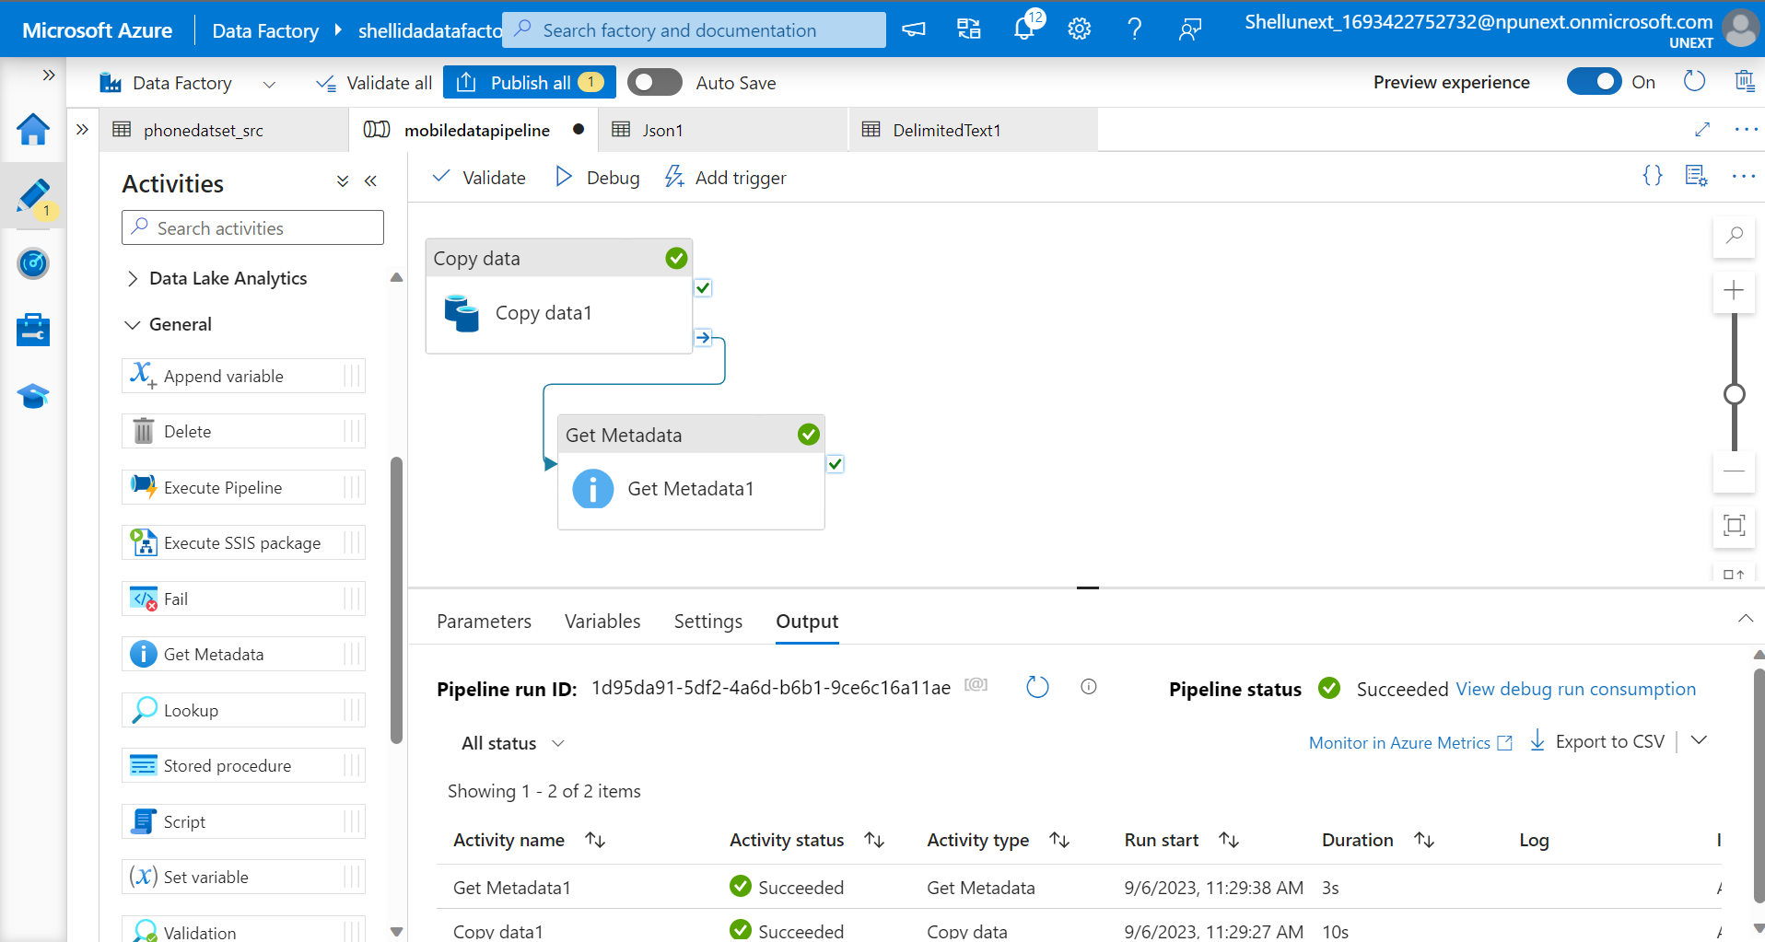
Copy data

Slide 9
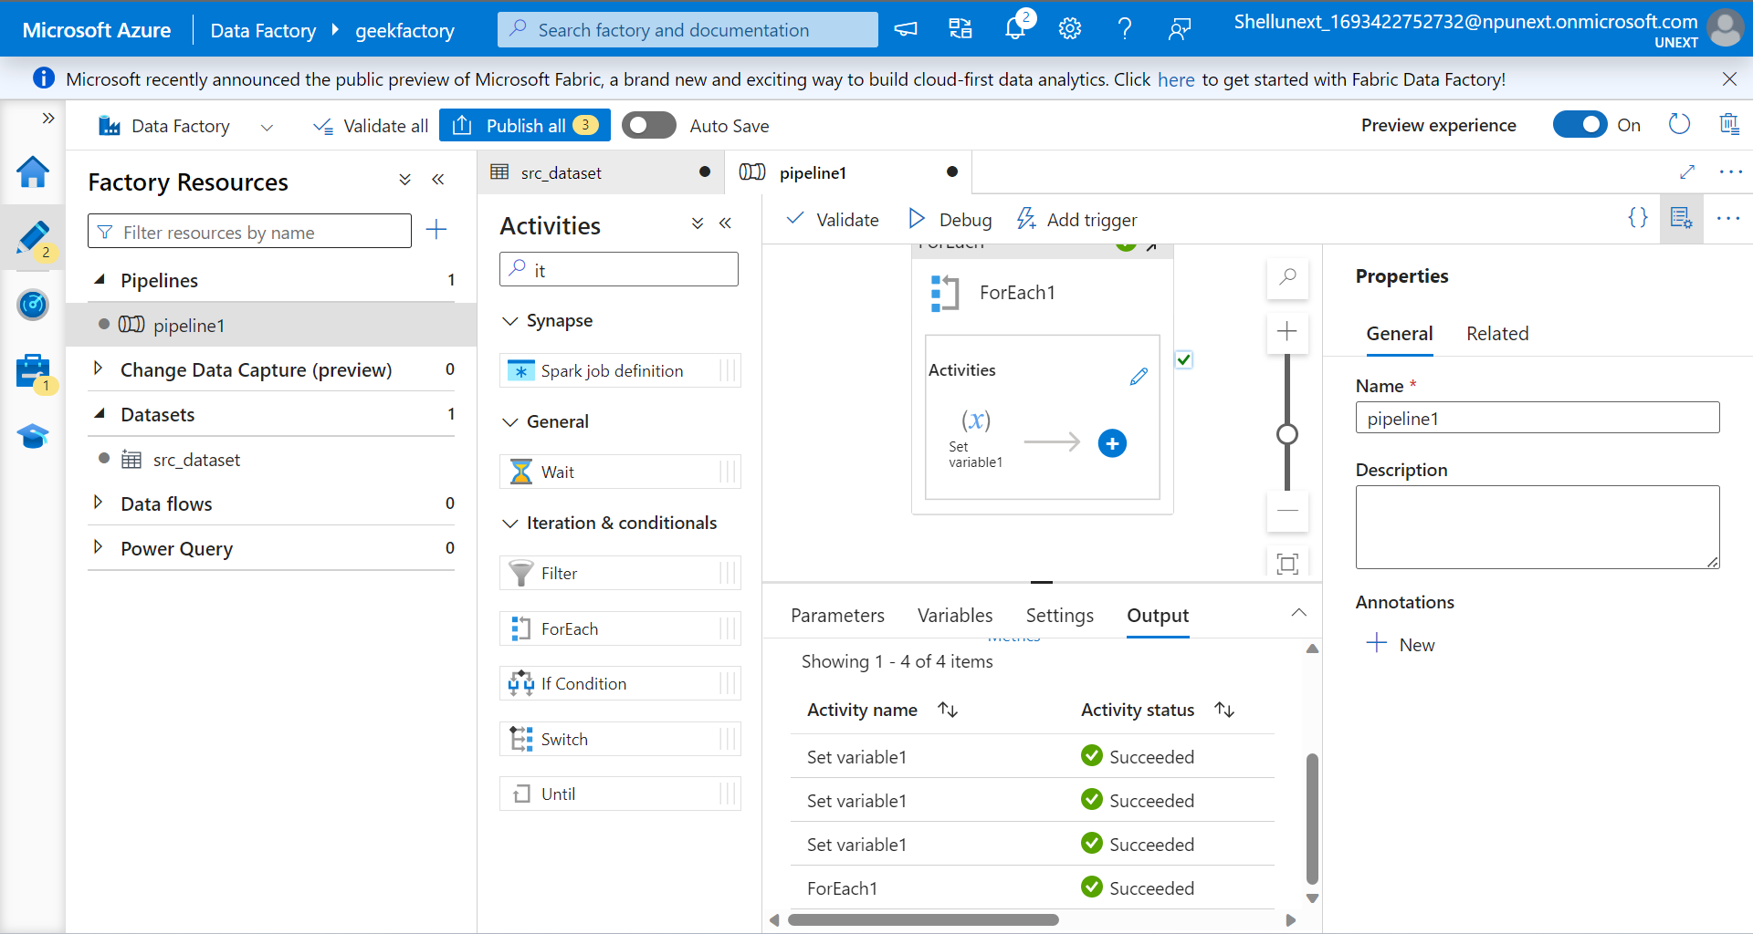
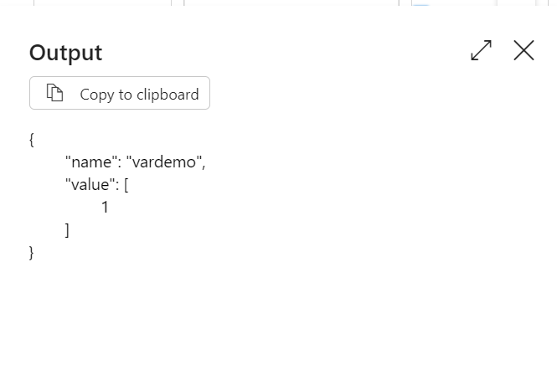
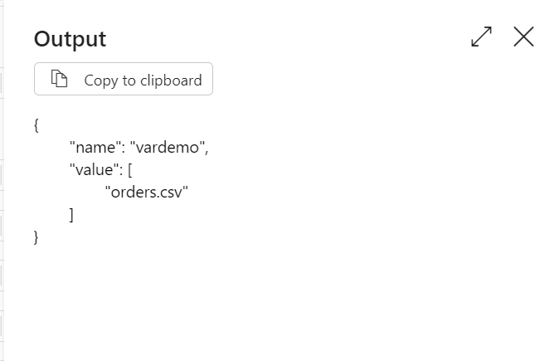
For each

Slide 10
Scenario:
You work for a global e-commerce company that sells products in multiple regions and nations. You have a dataset with sales data, including customer information, region and nation details, order information, and line items. Your goal is to create a data pipeline in Azure Data Factory to perform the following tasks:
Copy Data: Ingest the raw sales data from various sources (e.g., CSV files, databases) into Azure Data Lake Storage.
ForEach Loop: Iterate through the ingested files, one by one, to process each region's sales data separately.
If Condition: Check if the current region's data is valid for processing (e.g., data quality checks, completeness).
Parameterization: Use parameters to dynamically set values like file paths, folder names, and thresholds for data validation.
Derived Column: Add calculated columns to the dataset, such as total order cost, profit margins, or date-related attributes.
Join: Combine data from different sources, like customer information and order details, using appropriate keys.
Conditional Split: Based on business rules, split the data into different streams for further processing. For example, separate high-value orders from regular ones.

Slide 11
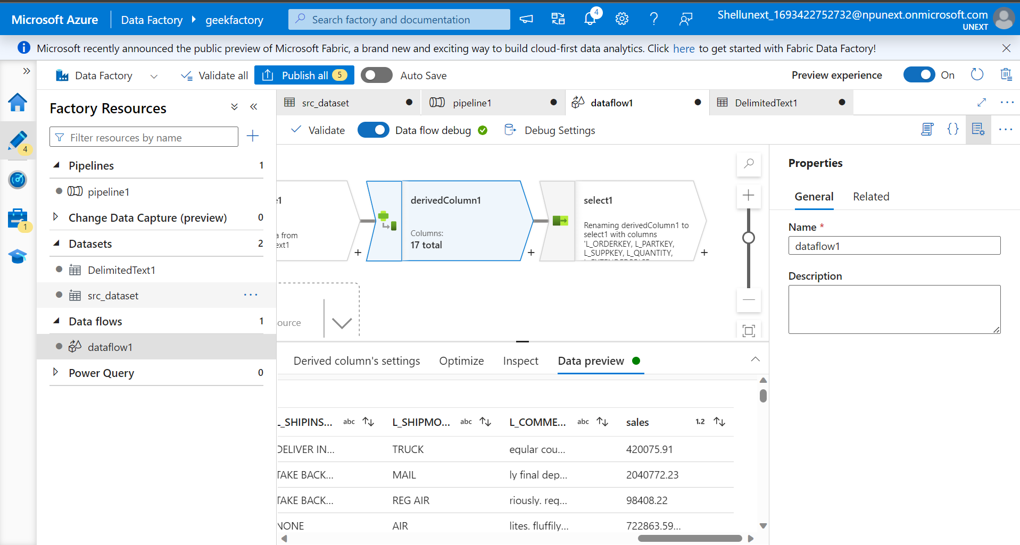
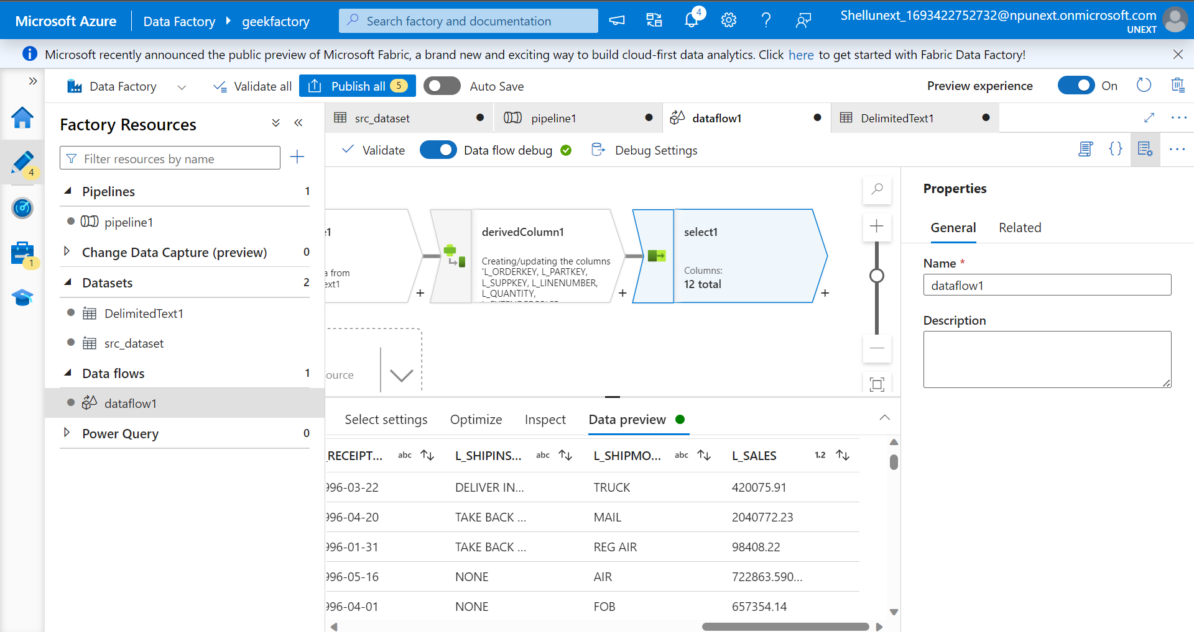
Data flow to add a new column and select the required columns

Slide 12
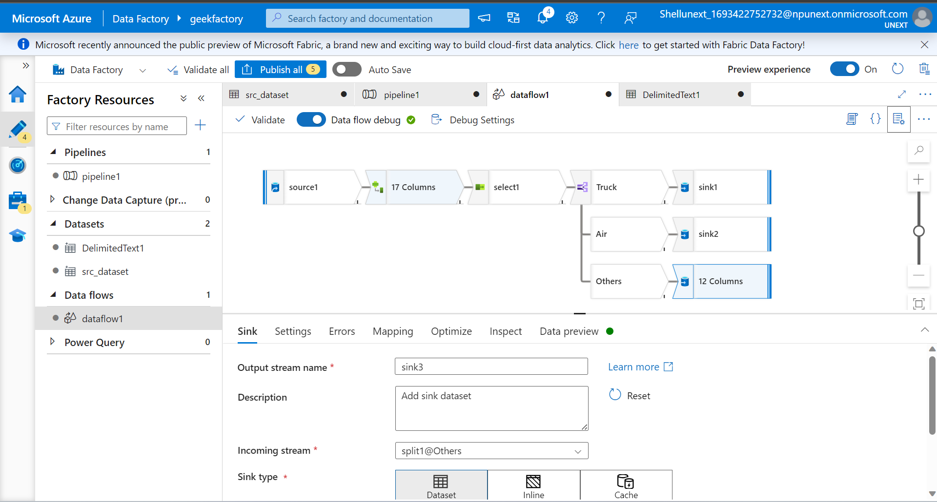
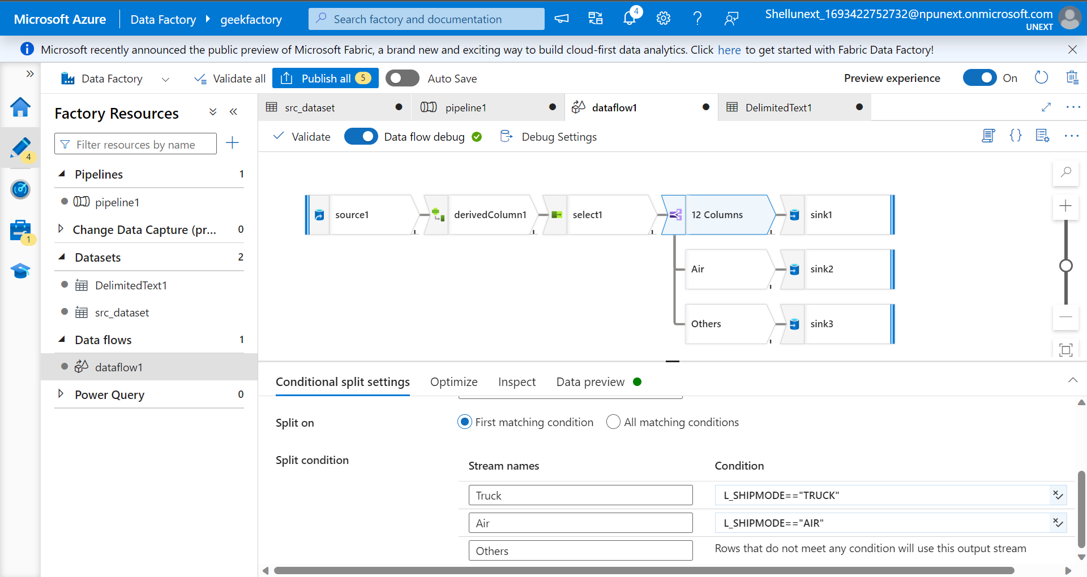

Conditional split

Slide 13
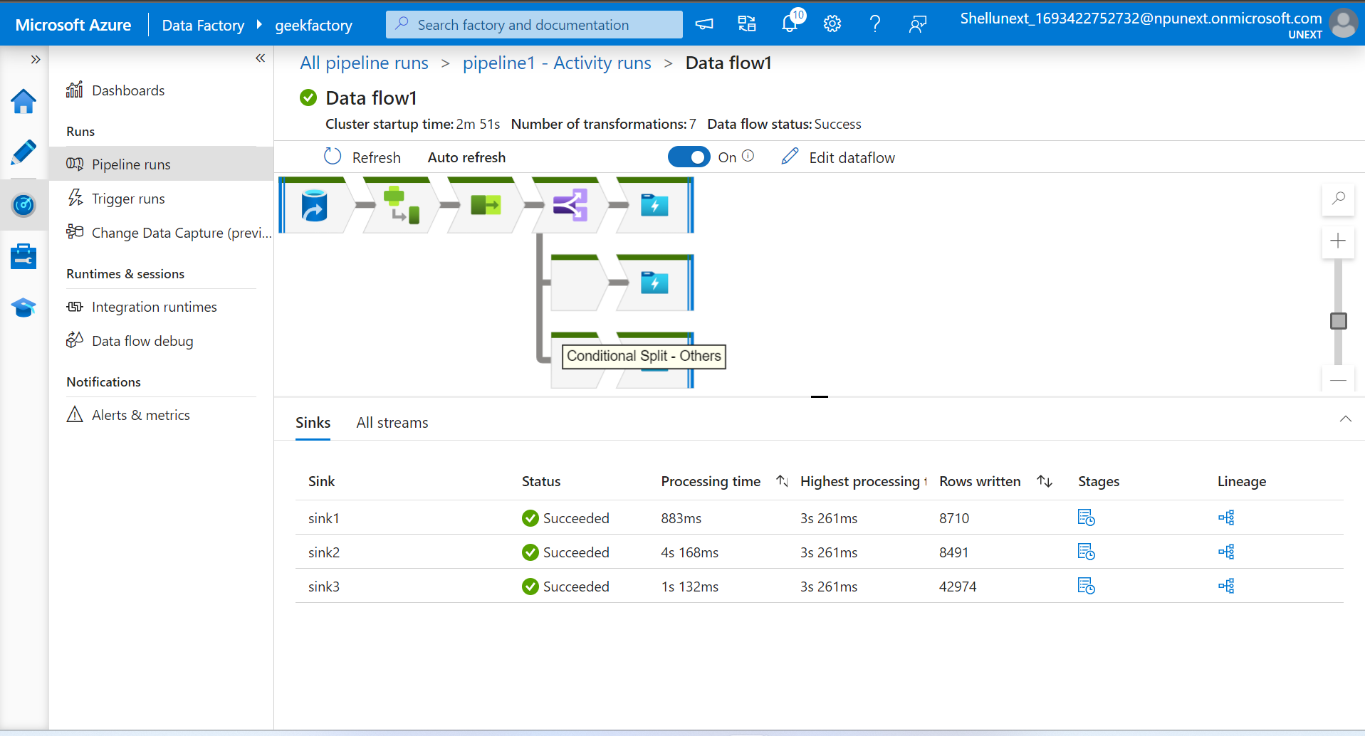
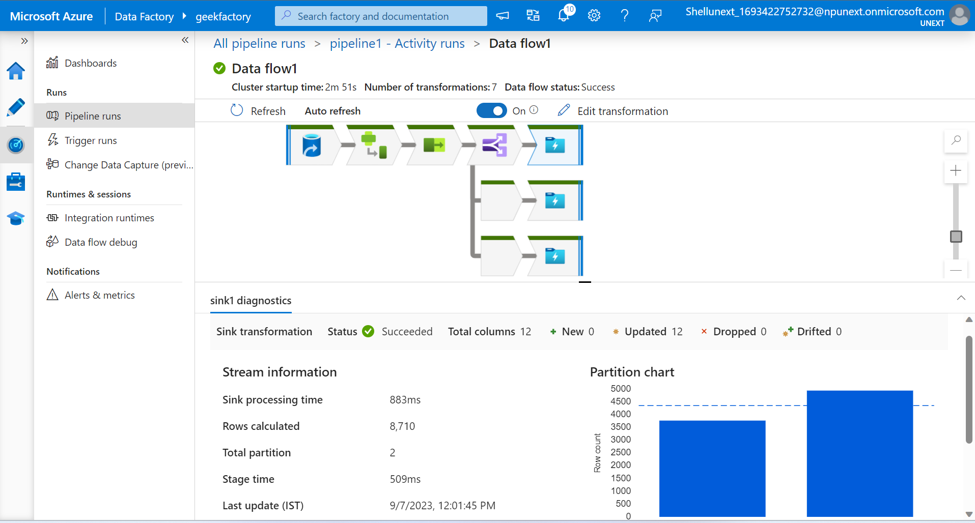
Monitoring the pipeline

Slide 14
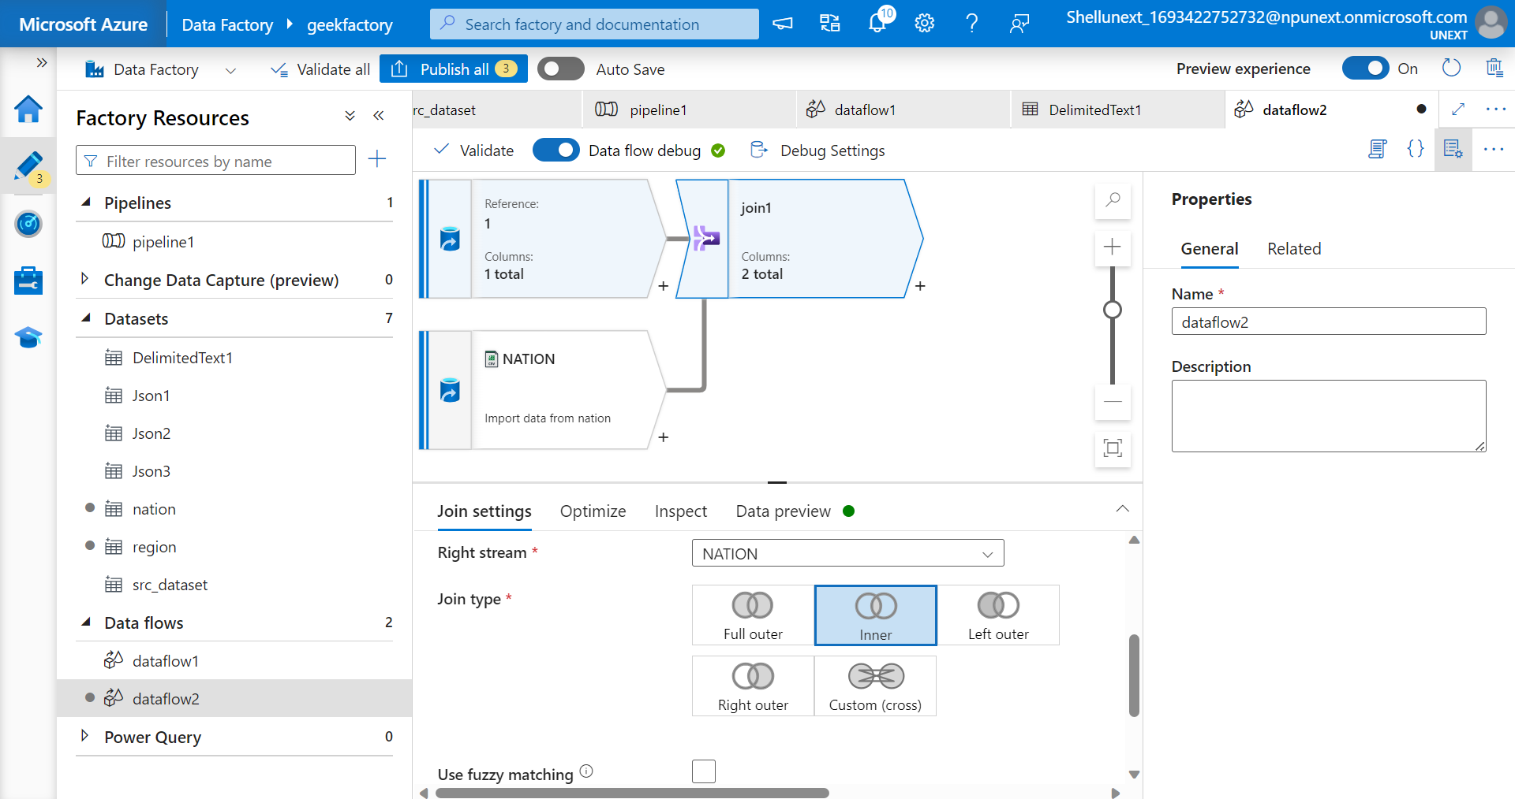
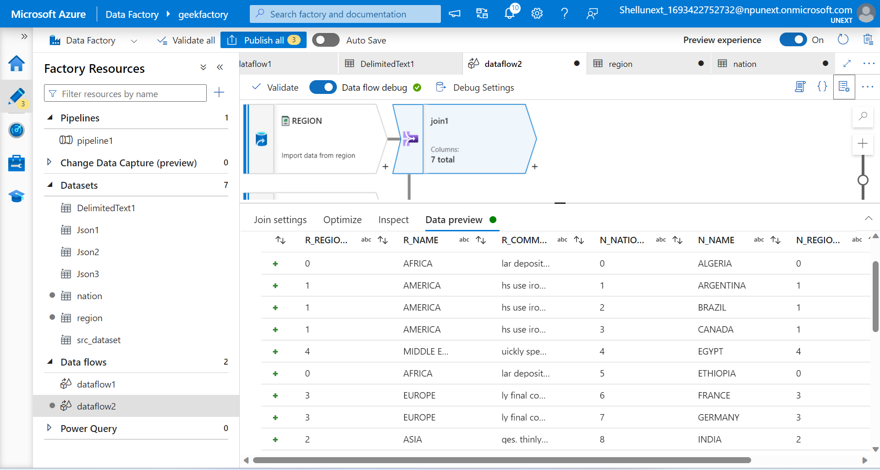
Joins

Slide 15
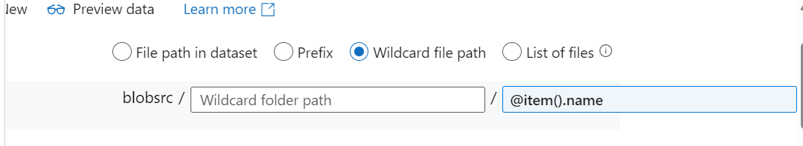
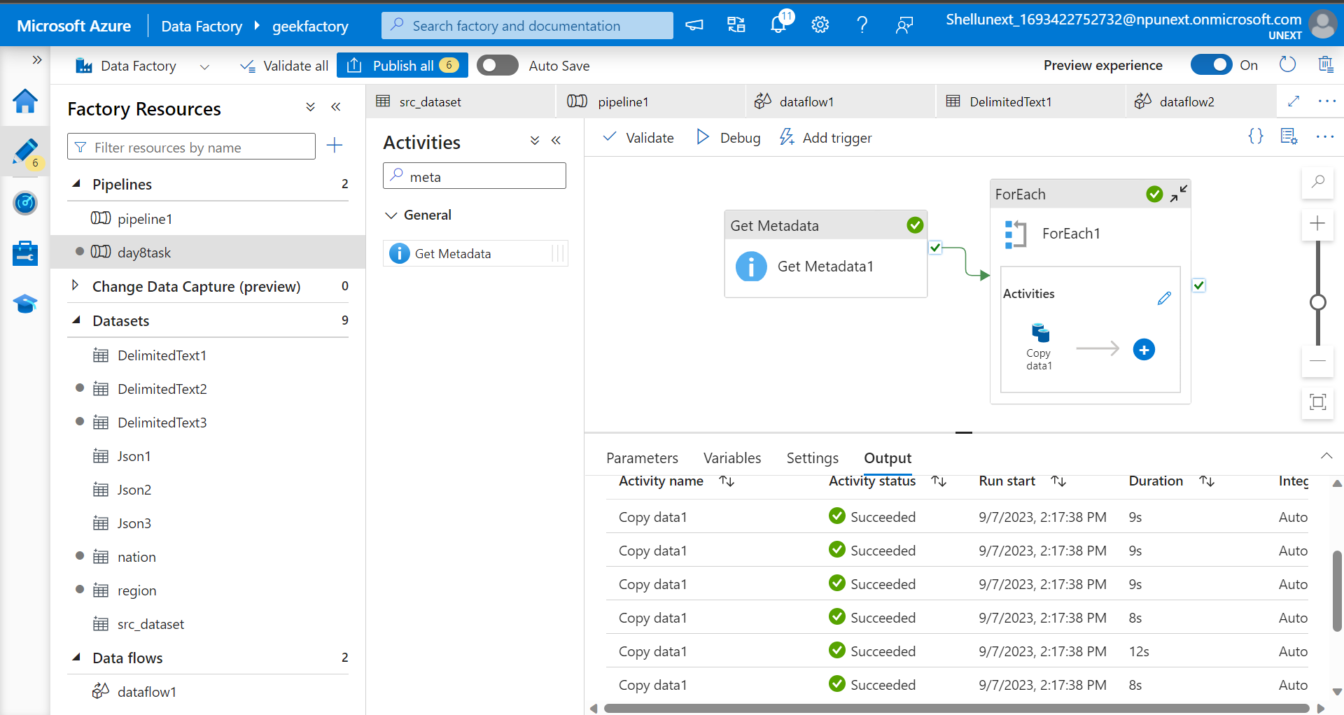
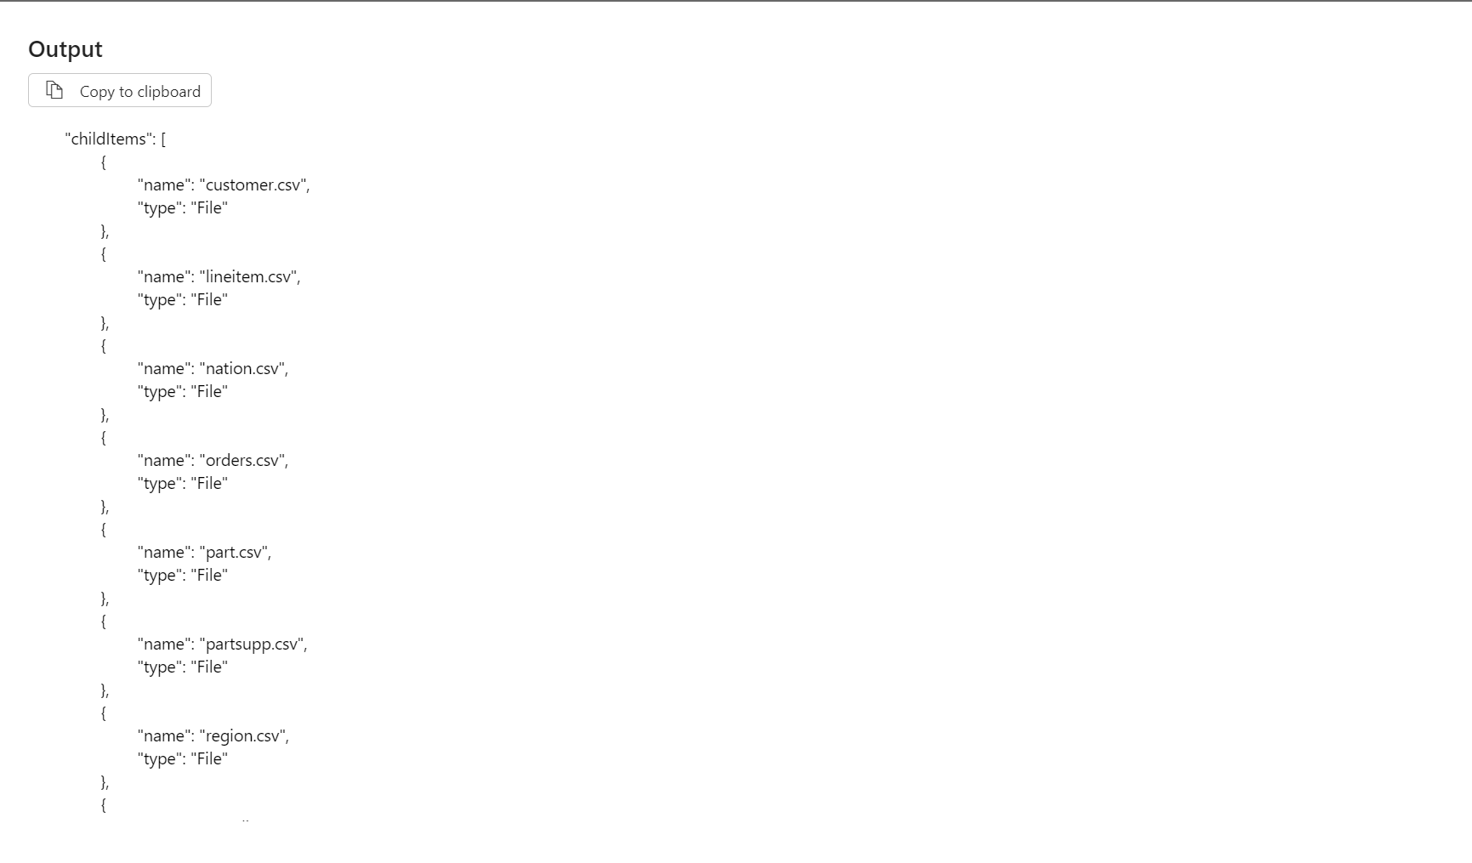
Copy Data: Ingest the raw sales data from various sources (multiple data ) into Azure Data Lake Storage.

Slide 16
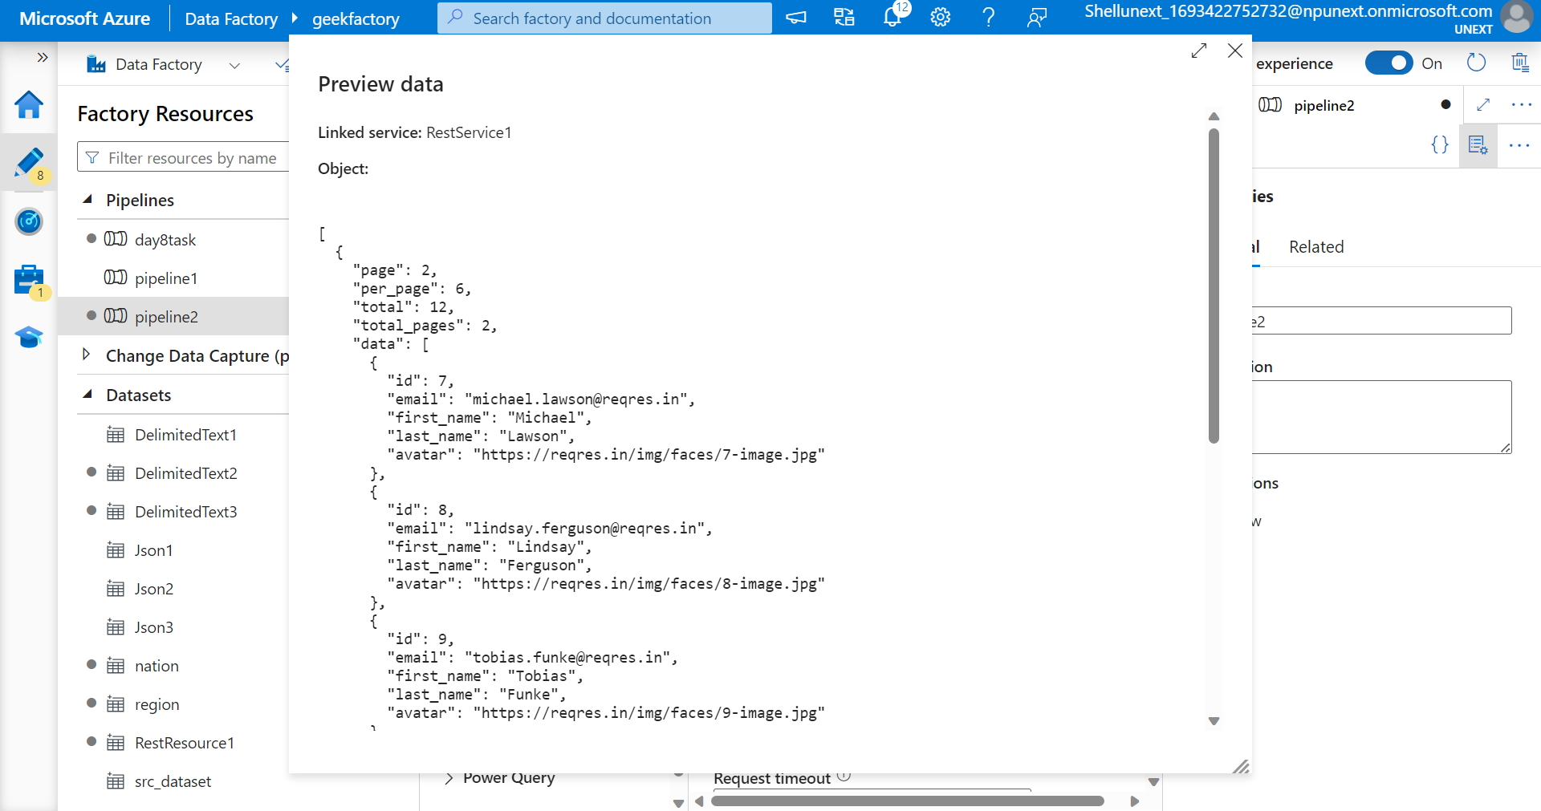
Rest API

Slide 17
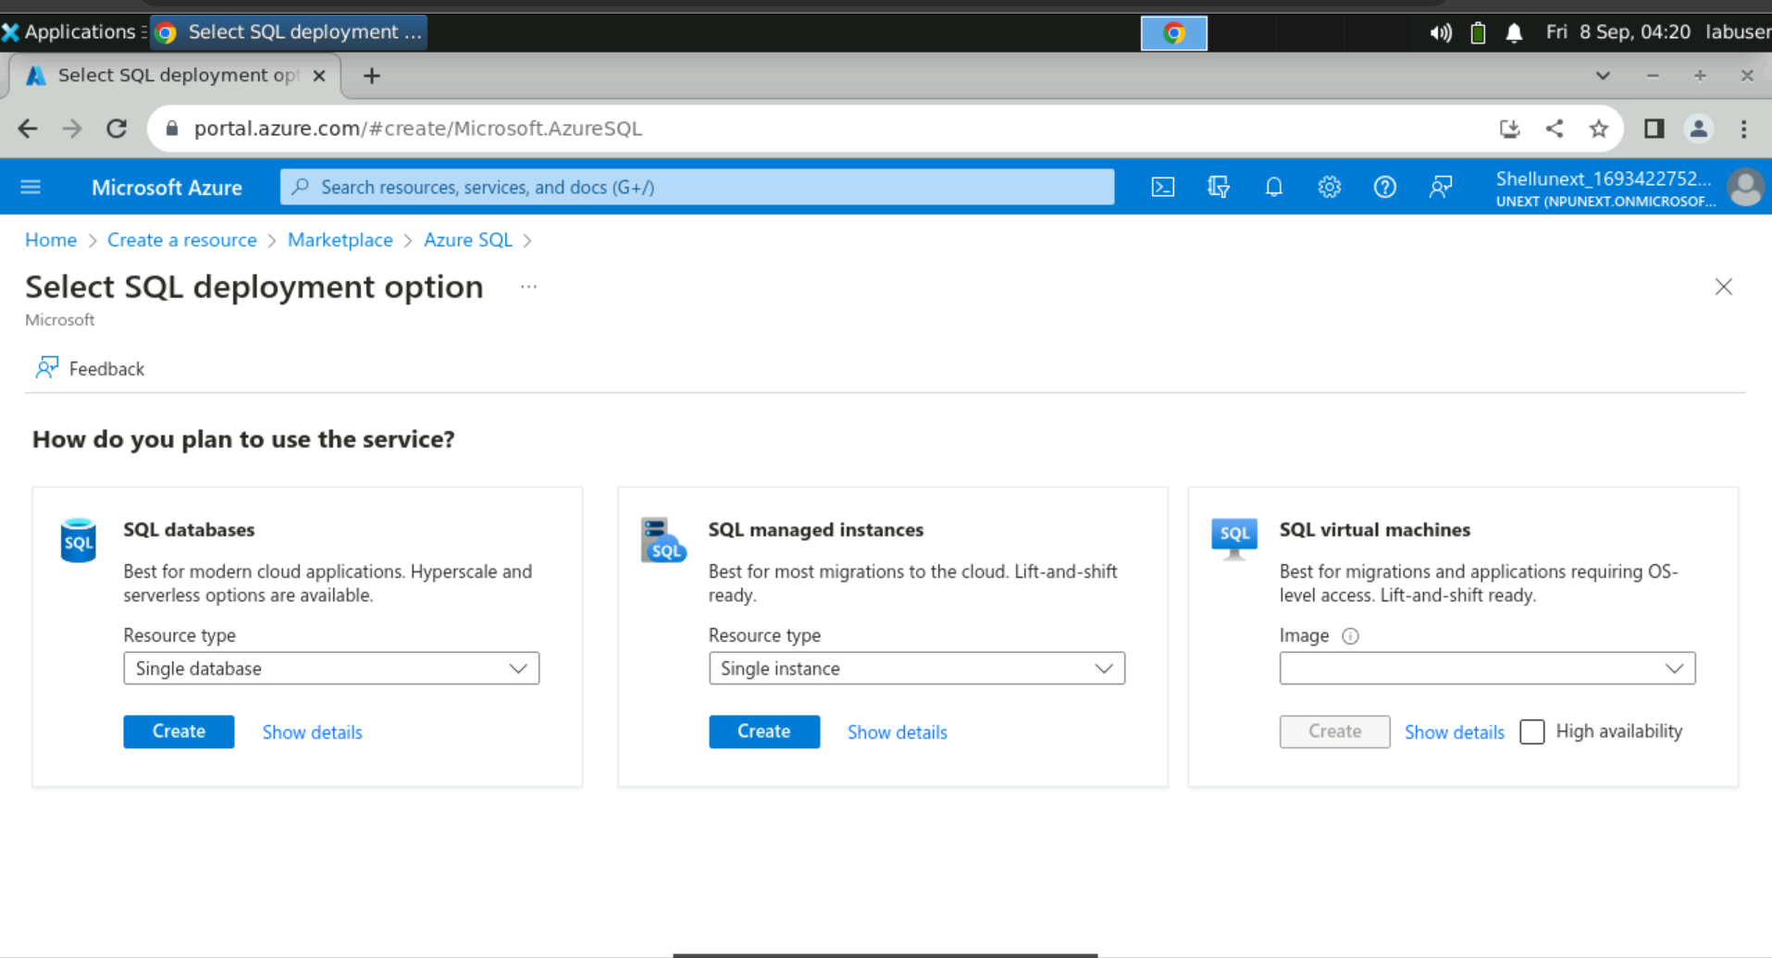
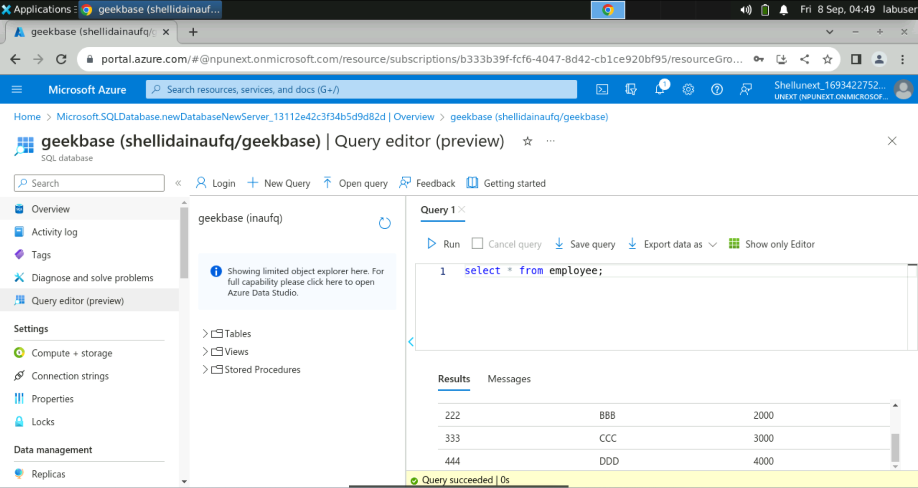
Creating a new database

Slide 18
